Slide 1

Neural Network Introduction and Application
By: Er. Aarti Sharma
Associate Professor
Department :CSE

Slide 2
Topics Covered:
What is Artificial Neural Network(ANN)?
Relationship between Biological neural network and artificial neural network.
Neurons
Activation Function
Basic architecture of an artificial neural network
Neural Network Application
Advantages and Disadvantages

Slide 3
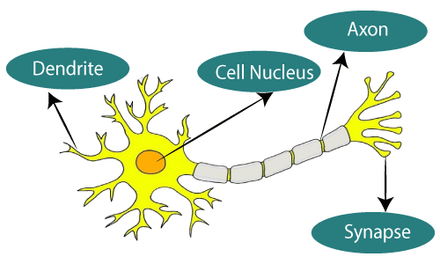
Biological Neuron Model
The term "Artificial Neural Network" is derived from Biological neural networks that develop the structure of a human brain. Similar to the human brain that has neurons interconnected to one another, artificial neural networks also have neurons that are interconnected to one another in various layers of the networks. These neurons are known as nodes.
Biological Neural Network

Slide 4
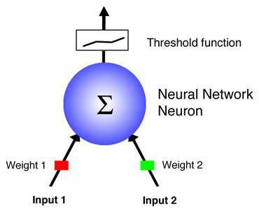
What is Artificial Neural Network(ANN)?
Neural Network architecture are inspired by Biological nervous system architecture composed of many simple processing elements operating in parallel whose function is determined by network structure, connection strength and processing performed at each node to obtain high computational rates.
Dendrites from Biological Neural Network represent inputs in Artificial Neural Networks,
cell nucleus represents Nodes,
synapse represents Weights, and
Axon represents Output.
Fig. : single neuron model

Slide 5
We can understand the artificial neural network with an example, consider an example of a digital logic gate that takes an input and gives an output.
Suppose "OR" gate, which takes two inputs. If one or both the inputs are "On," then we get "On" in output. If both the inputs are "Off," then we get "Off" in output. Here the output depends upon input.
Our brain does not perform the same task. The outputs to inputs relationship keep changing because of the neurons in our brain, which are "learning."

Slide 6
Relationship between Biological neural network and artificial neural network.
Biological neural network | Artificial neural network
Dendrites | Inputs
Cell nucleus | Nodes
Synapse | Weights
Axon | Output

Slide 7
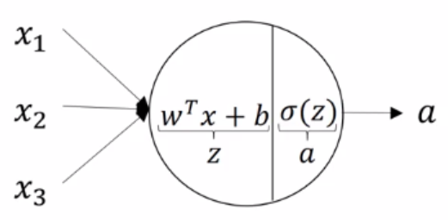
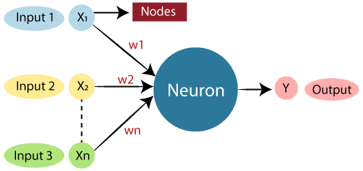

Neurons
The neuron is the atomic unit of a neural network.
Given an input, it provides the output and passes that output as an input to the subsequent layer.
A neuron can be thought of as a combination of 2 parts:
Z =
The first part computes the output Z, using the inputs and the weights.
The second part performs the activation on Z to give out the final output A of the neuron.

Slide 8
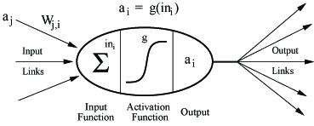
Neural Network neurons:
Receives N- inputs .
Multiplies each input by its weights.
Applies activation function (F )to the sum of results.
Output results.
It takes input and computes the weighted sum of the inputs and includes a bias. This computation is represented in the form of a transfer function.
It determines weighted total is passed as an input to an activation function to produce the output.

Slide 9
Activation Function
Activation functions(F) refer to the functions used in neural networks to compute the weighted sum of input and biases, which is used to choose the neuron that can be fire or not.
It produces an output for the neural network that includes the parameters in the data.
There are some activation function that are used in ANN:
Linear Activation Function
Non Linear Activation Function

Slide 10
Linear Activation function:
It is the same as the equation of a straight line i.e. Y= MX+ C
The range of a linear function is –infinitive to + infinitive.
Linear activation function can be used at only one place that is the output layer.

Slide 11
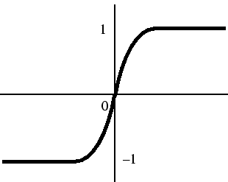
Non Linear Activation function:
Sigmoid function:
It is a function that is projected as S - shaped graph.
A = 1/(1+e^{-x})
This function is non-linear, and the values of x lie between -1 to +1.
The value of X is directly proportional to the values of Y.

Slide 12
Non Linear Activation function:
Tanh Function:
The activation function, which is more efficient than the sigmoid function is Tanh function.
It is also known as Tangent Hyperbolic Function.
F(x)= tanh(x) = 2/(1+e^{-2X}) – 1
OR
Tanh (x) = 2 * sigmoid(2x) – 1
It is non Linear.
Its value range lies between -1 to +1

Slide 13
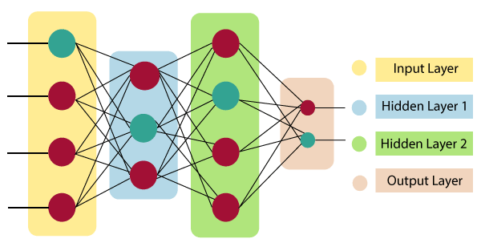
The architecture of an artificial neural network
Artificial Neural Network primarily consists of three layers:
Input Layer: It accepts inputs in several different formats provided by the programmer.
Hidden Layer:The hidden layer presents in-between input and output layers. It performs all the calculations to find hidden features and patterns.
Output Layer:The input goes through a series of transformations using the hidden layer, which finally results in output that is conveyed using this layer.

Slide 14
Neural Network Applications
Pattern Recognition
Mobile Computing
Investment Analysis
Control System and Monitoring
Textual Analysis
Marketing and financial Analysis
Facial Recognition
Hand-Writing Recognition

Slide 15
Advantages
A neural network can perform task that a linear program can not.
A neural program learns and does not need to be reprogrammed.
When an element of neural network fails,it can continue without any problem by there parallel nature .
It can be implemented in any application.
It can be implemented without any problem.

Slide 16
Disadvantages
It need training to operate.
Requires high processing time for large neural networks.
Hard to design large neural networks.
Architecture of neural network is difficult from architecture of microprocessor therefore needs to be emulated.

Slide 17
Thank You!

